Slide 1

Mountaineer
The D is silent.

Slide 2
Problem
Existing Apps are not designed for moutain climbers
They miss some important information:
Covered altitude
Time spent walking uphill/downhill
Calculation of calories

Slide 3
Solution

Slide 4
Solution
Android App
Specialized for Mountaineers

Slide 5
Functionality
Add tours/trips
Monitor weather and health information
Display details of completed tours
Tracking of altitude
Subject to change without prior notice.

Slide 6
What kind of Details?
General information
Track/Route details
Weather information
Health
Subject to change without prior notice.

Slide 7
Technical Stuff
Firebase
For Training Units
Used for Fast-Prototyping
Dedicated Database on Webserver for Production
More Details coming soon ;)
Subject to change without prior notice.

Slide 8
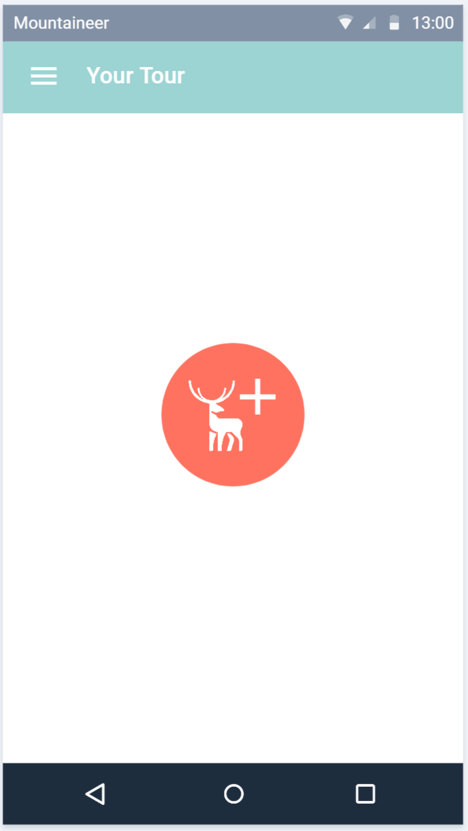
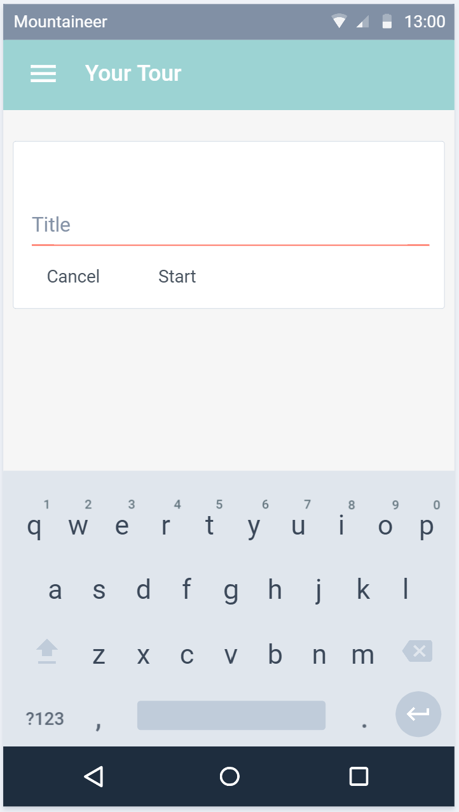
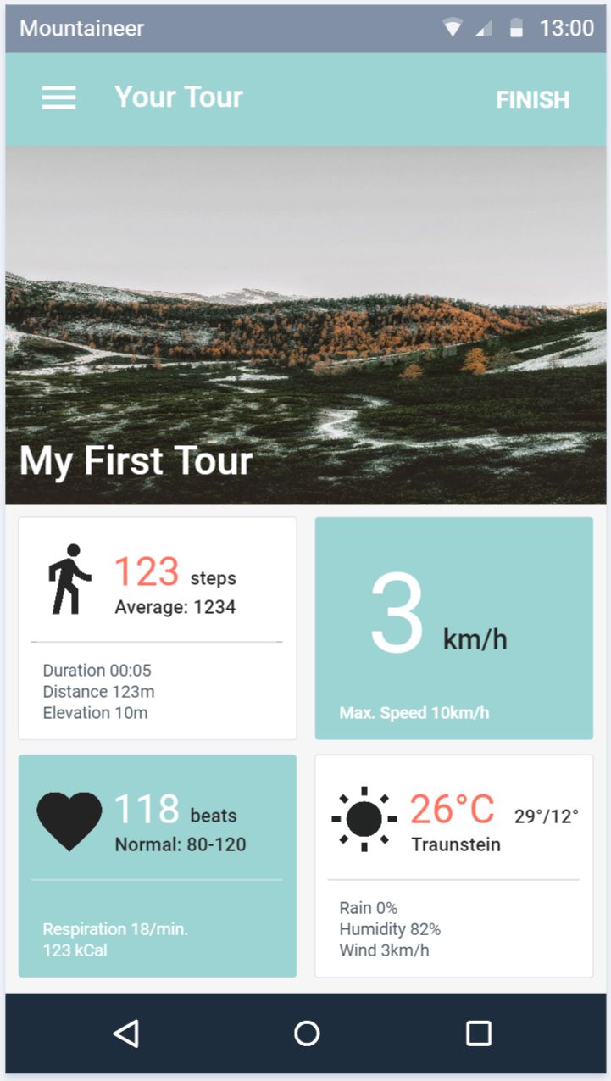
Planned Design
Subject to change without prior notice.

Slide 9
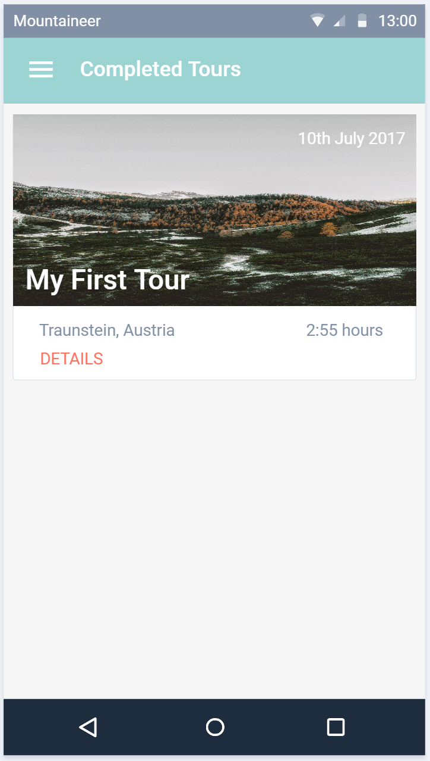
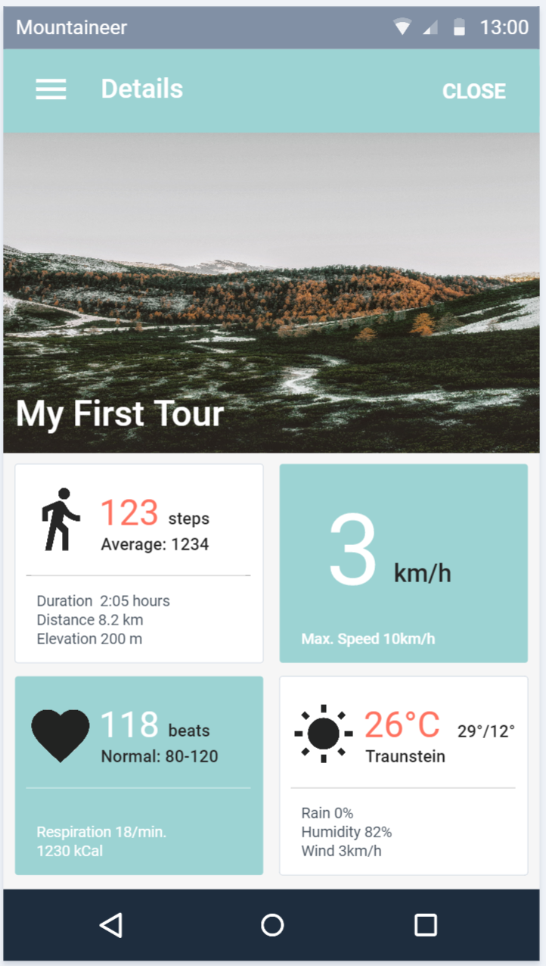
Planned Design
Subject to change without prior notice.

Slide 10
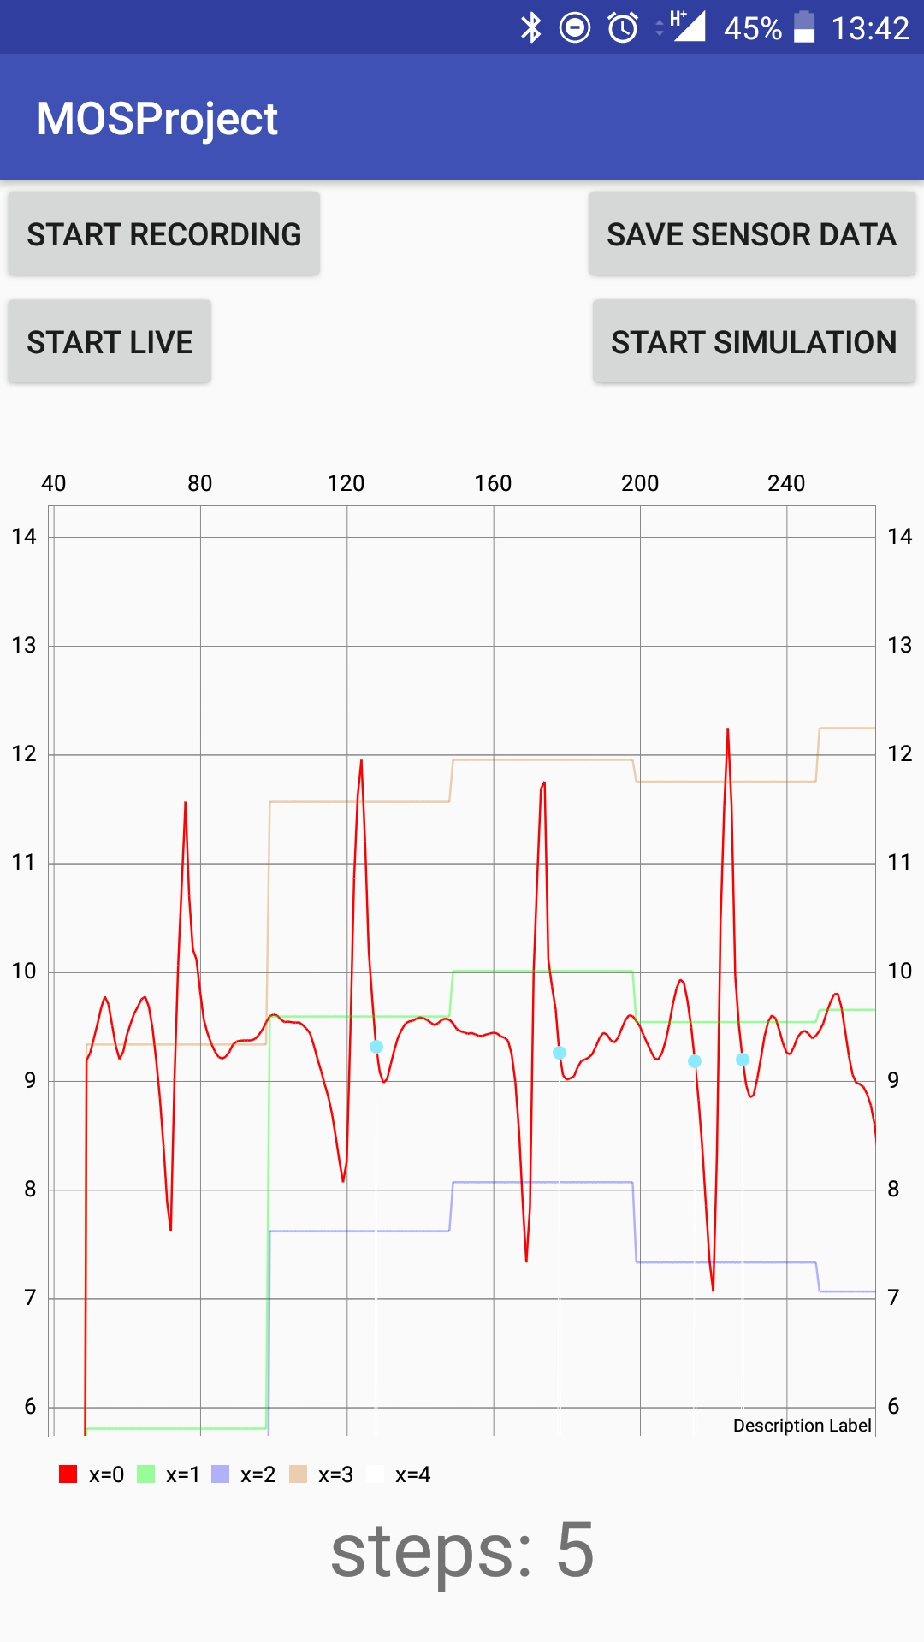
Pedometer
Simulation + Live-View
Graph
Used for debugging and testing
Firebase
Running as a Service
Implemented according to the PDF
But with little parameter adjustments

Slide 11
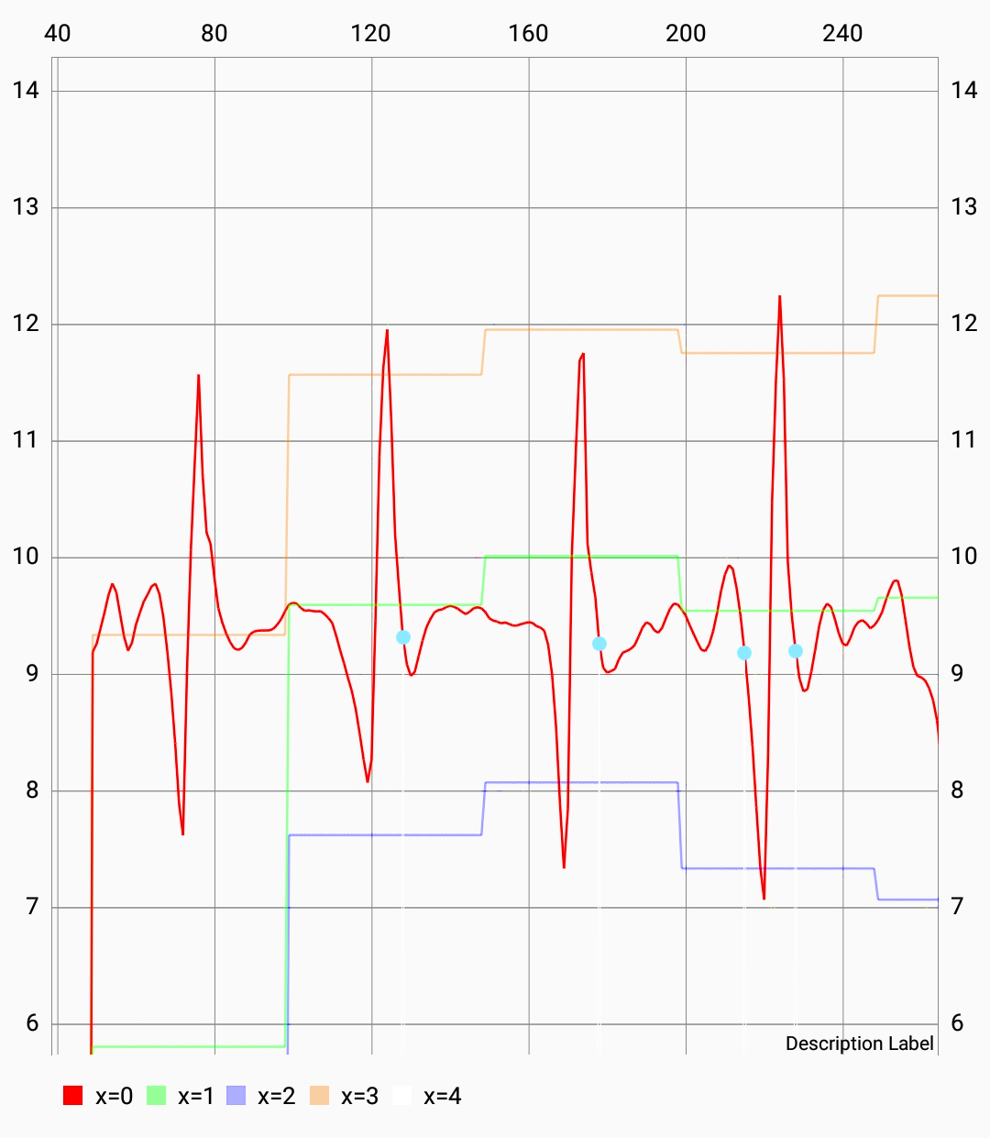
Chart Details
Measured values
Max + Min
Threshold
Detected steps

Slide 12
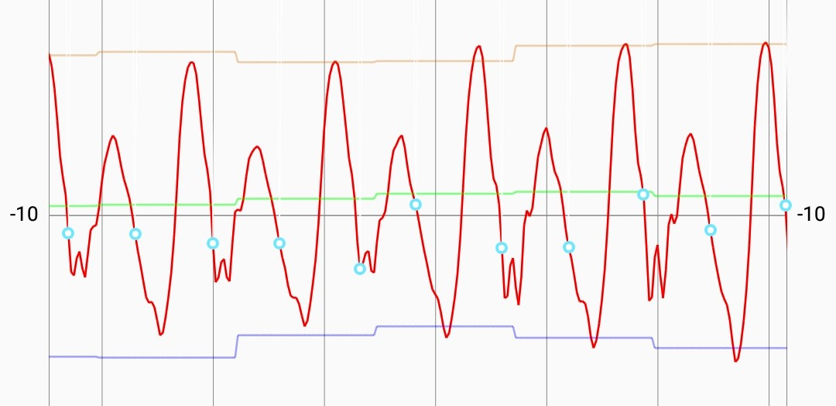
Acceleration of morning walk to FH

Slide 13
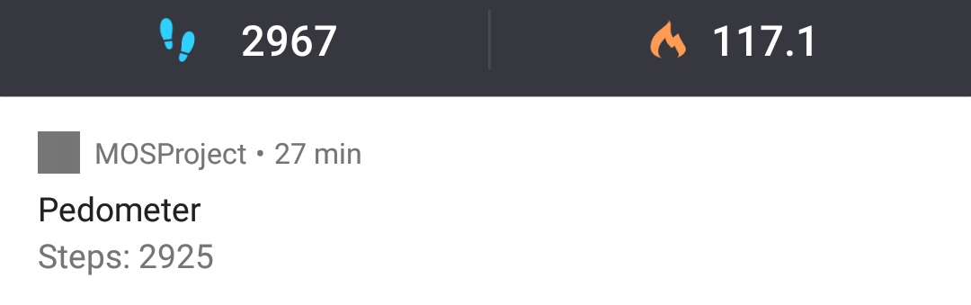
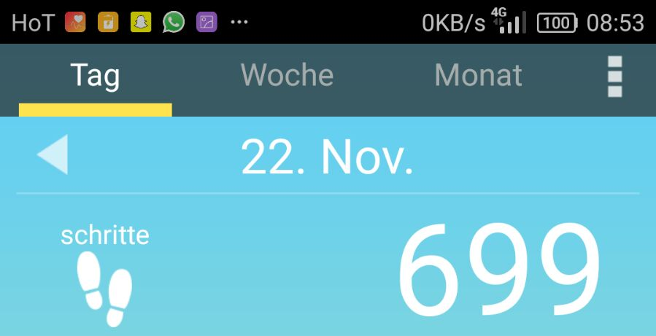
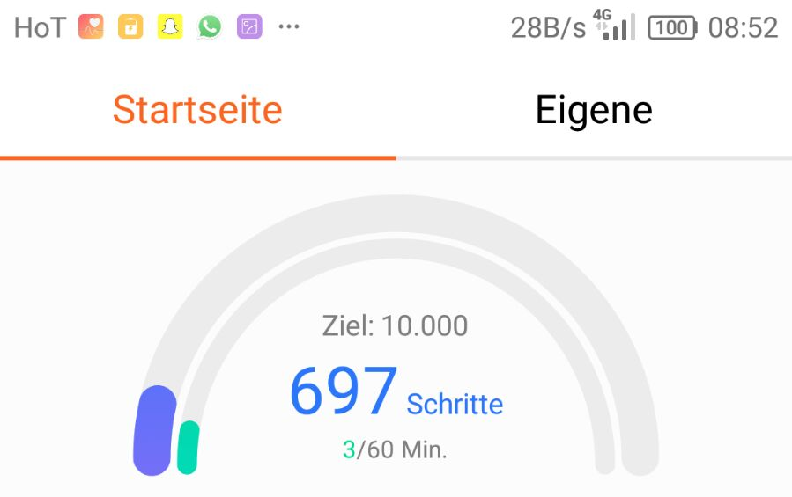
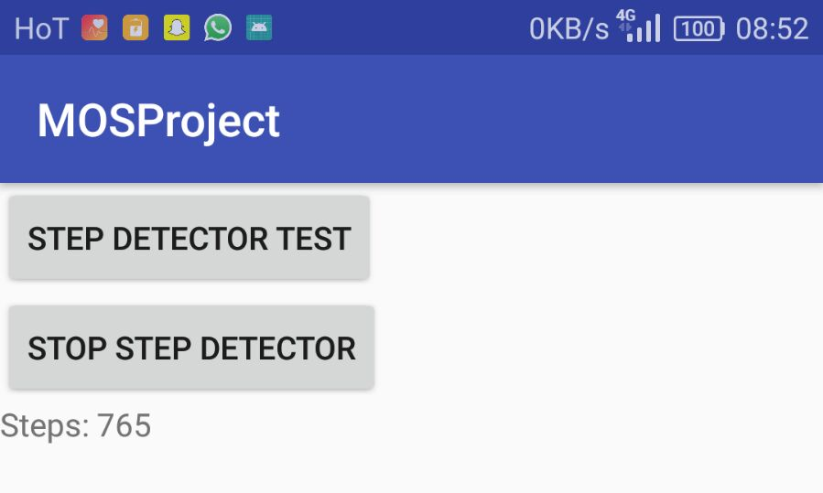
Competition Analysis
Accuracy compared to:
Pedometer
Huawei Health
Schrittzähler

Slide 14
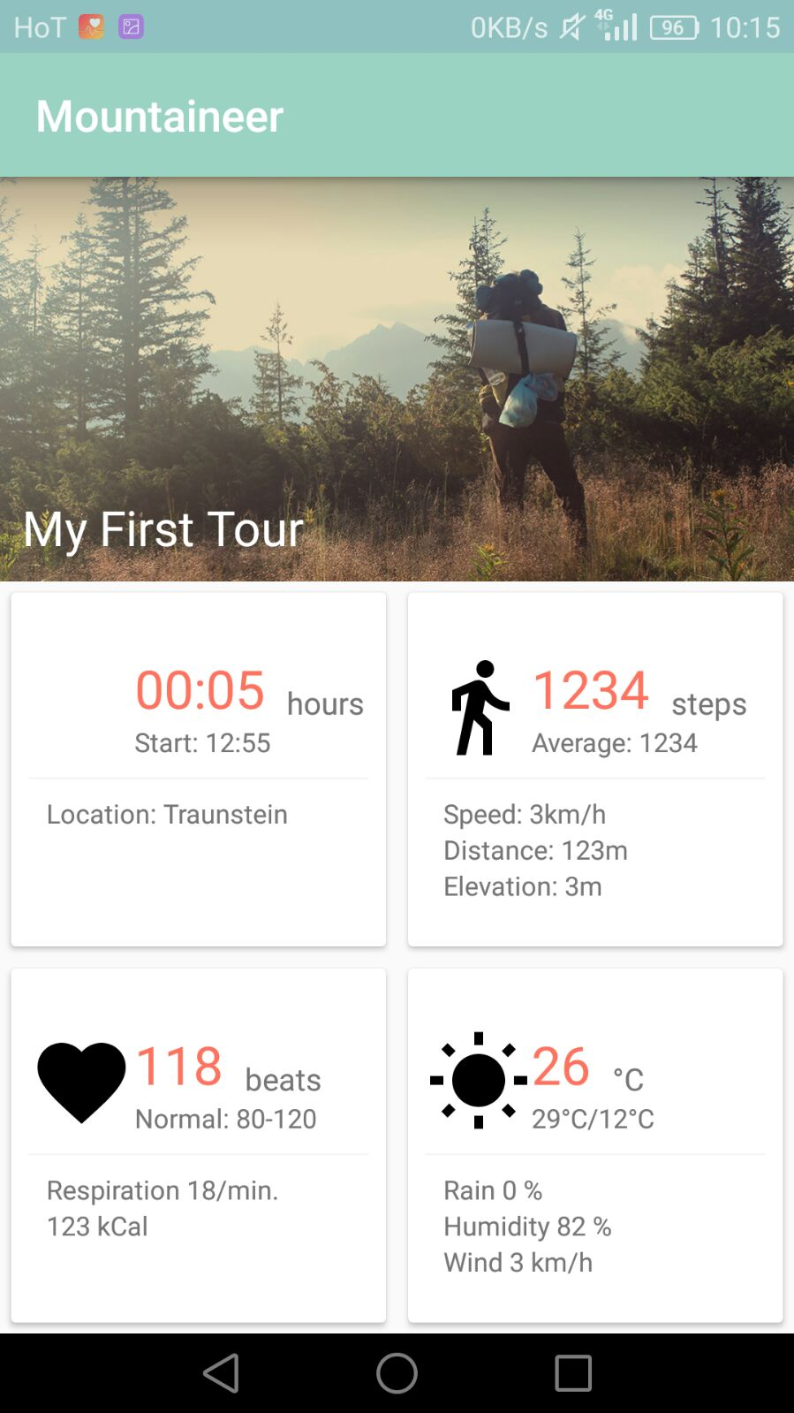
UI is (almost) ready
and waiting for functionality

Slide 15
Thanks!

Slide 16
Mountaineer
An Update.

Slide 17
Heart Rate Monitoring #1
Simulation of Heartrate Sensor
Bluetooth LE connection
Calculate
Fitness
Fatigue
Performance

Slide 18
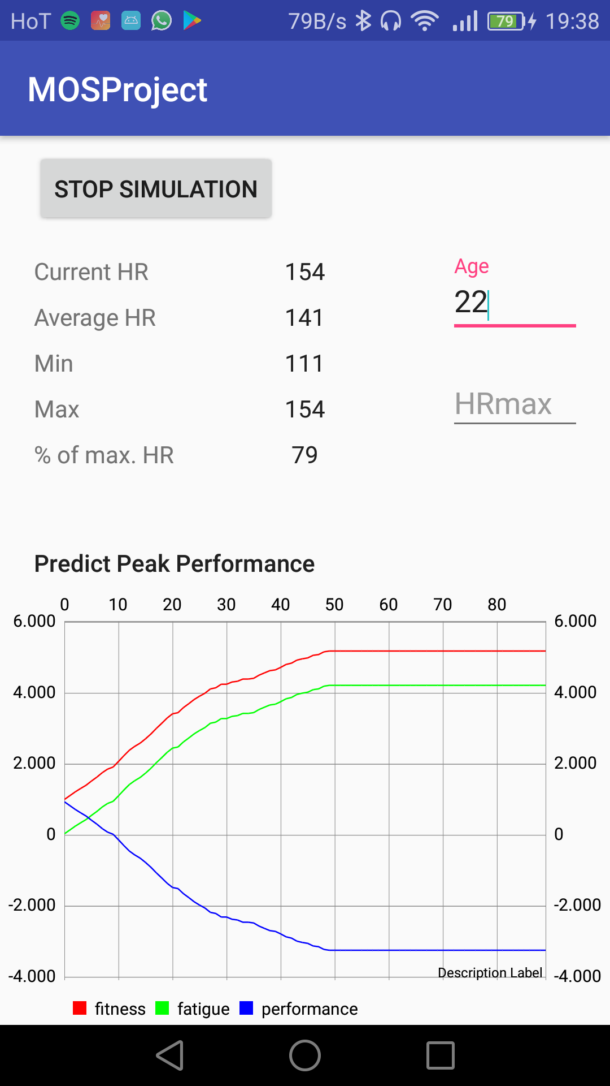
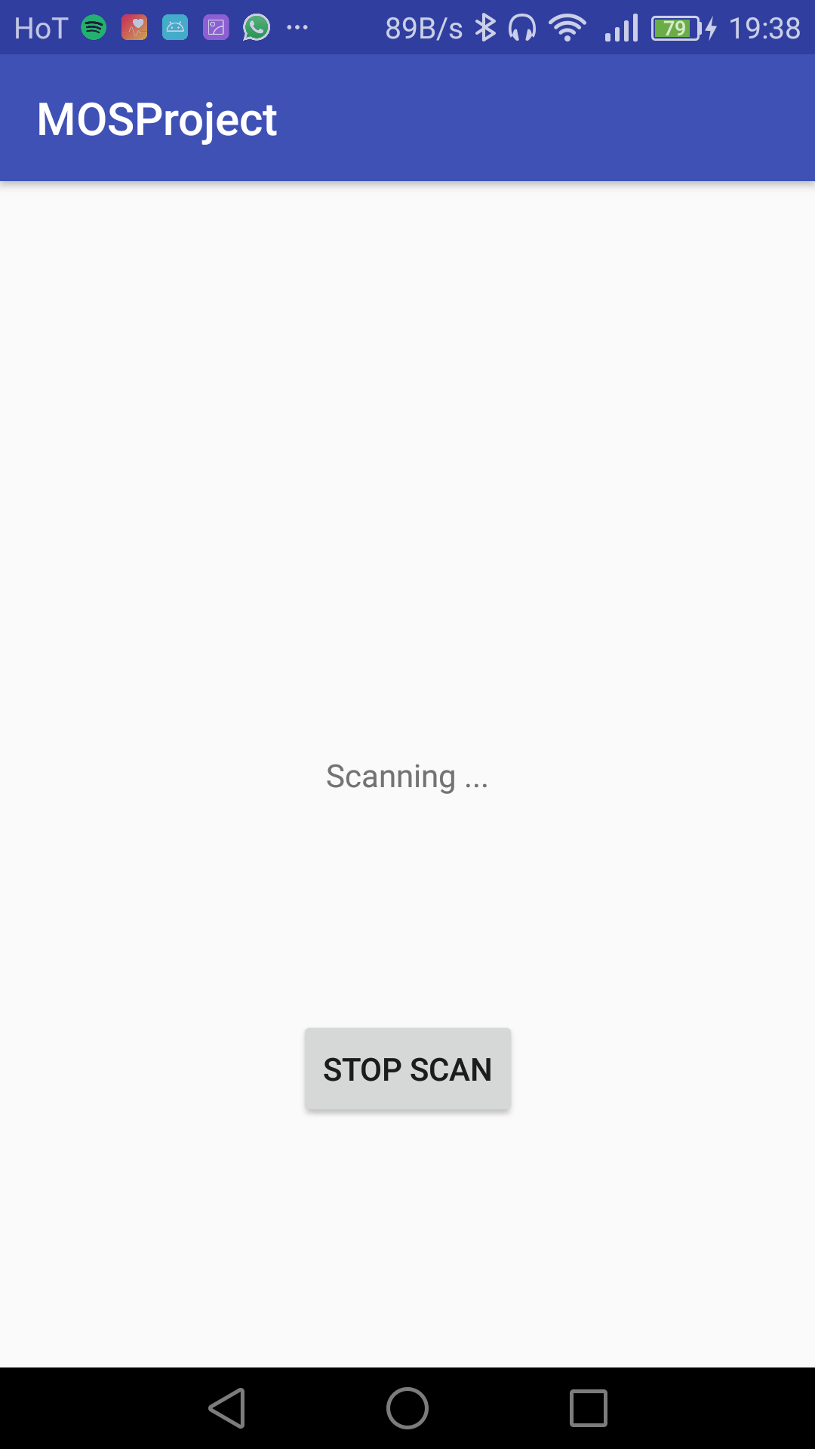
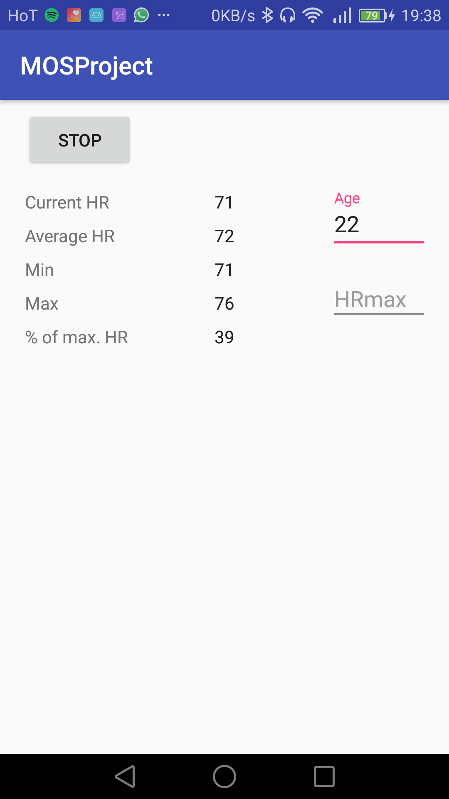
Heart Rate Monitoring #2

Slide 19
Heart Rate Monitoring #3

Slide 20
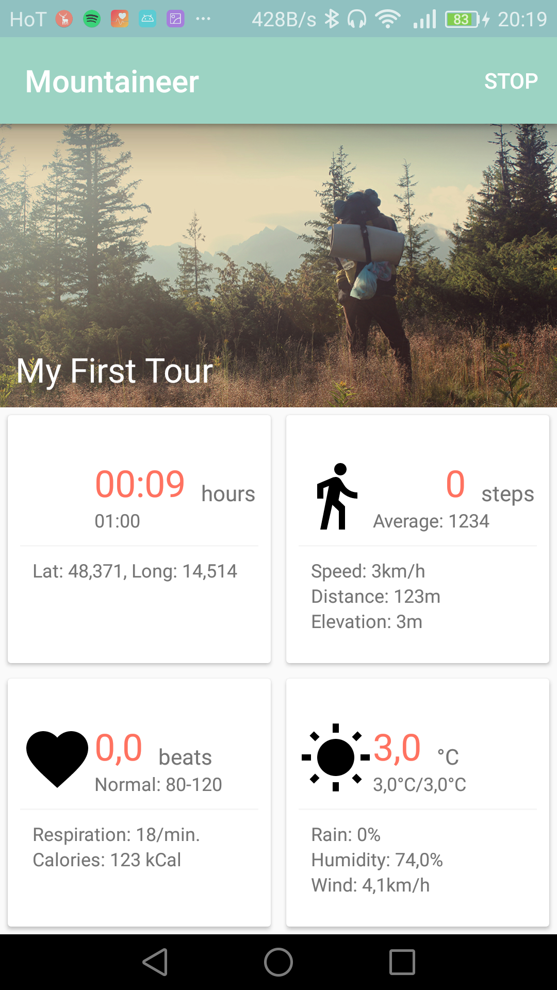
Android App #1
Basic Information
Stopwatch
Starttime
Location (GPS)

Slide 21
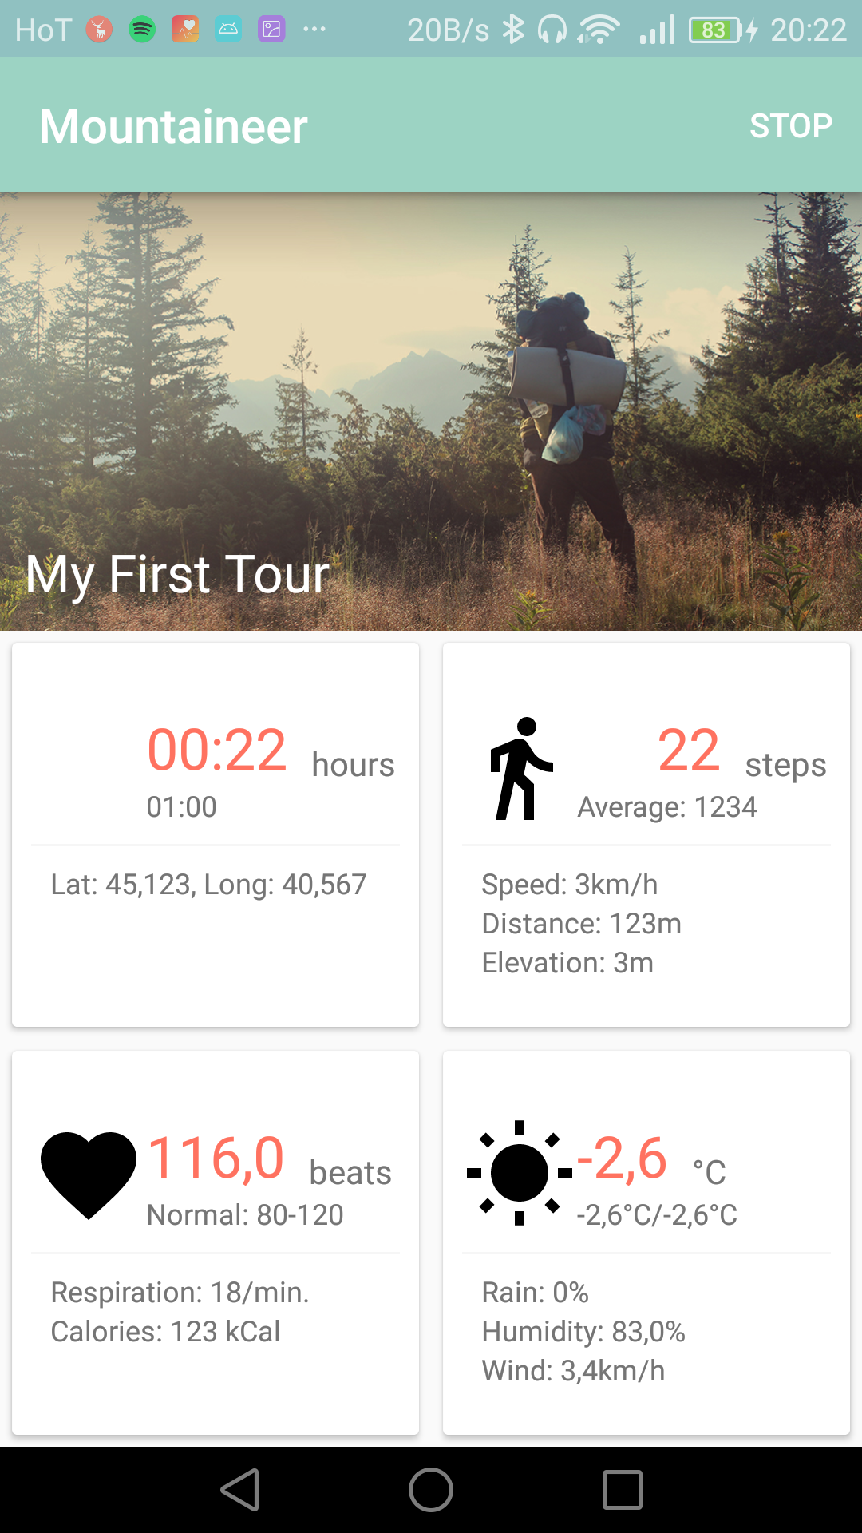
Android App #2
Step Count
Step Frequency

Slide 22
Android App #3
Heart Rate
Energy Expenditure
Bluetooth HR Monitor
Simulation

Slide 23
Android App #4
Weather Forecast
Temperature
Rain
Wind
OpenWeatherMap

Slide 24
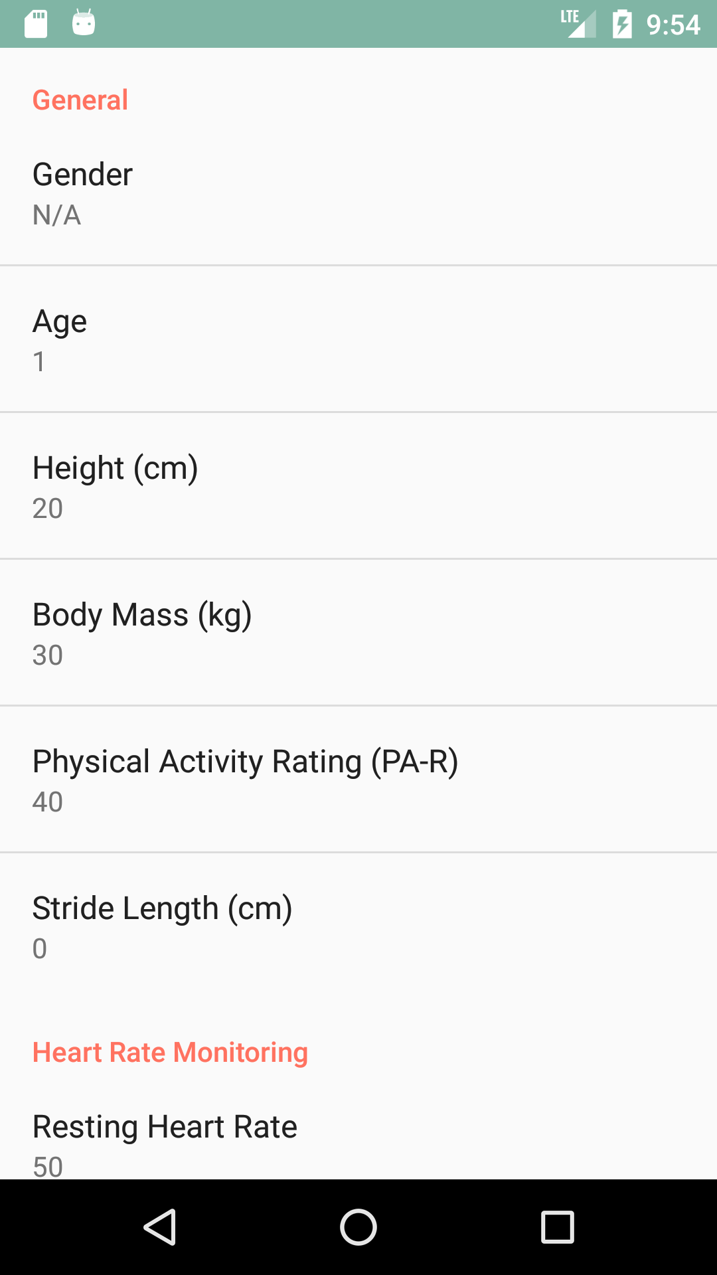
Android App #5
User Data
From Pedometer
Distance
Speed
Energy Expenditure

Slide 25
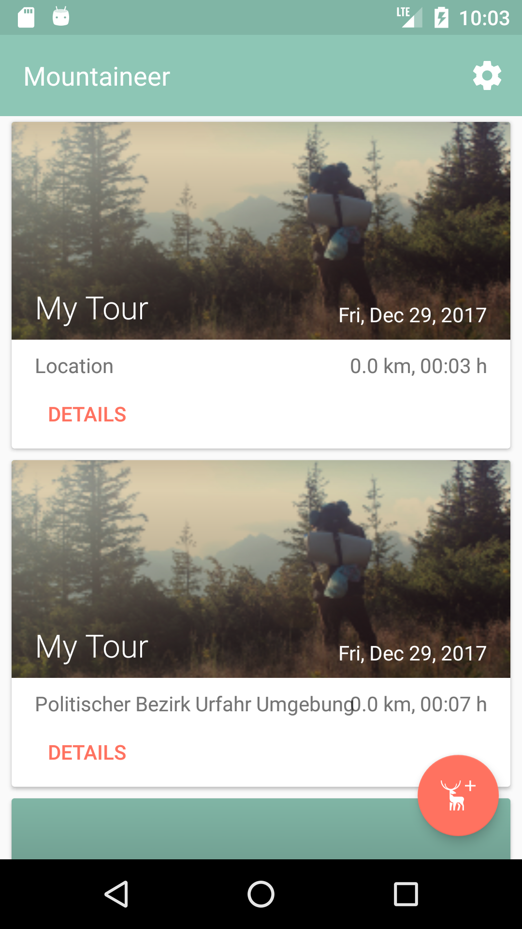
Android App Design #1
New UI
New Design

Slide 26
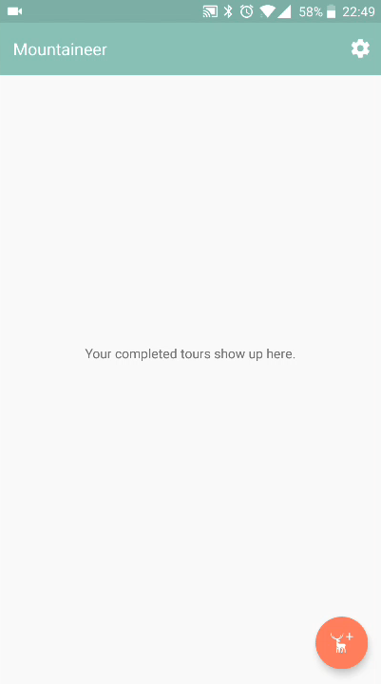
Android App Design #2
Demo!

Slide 27
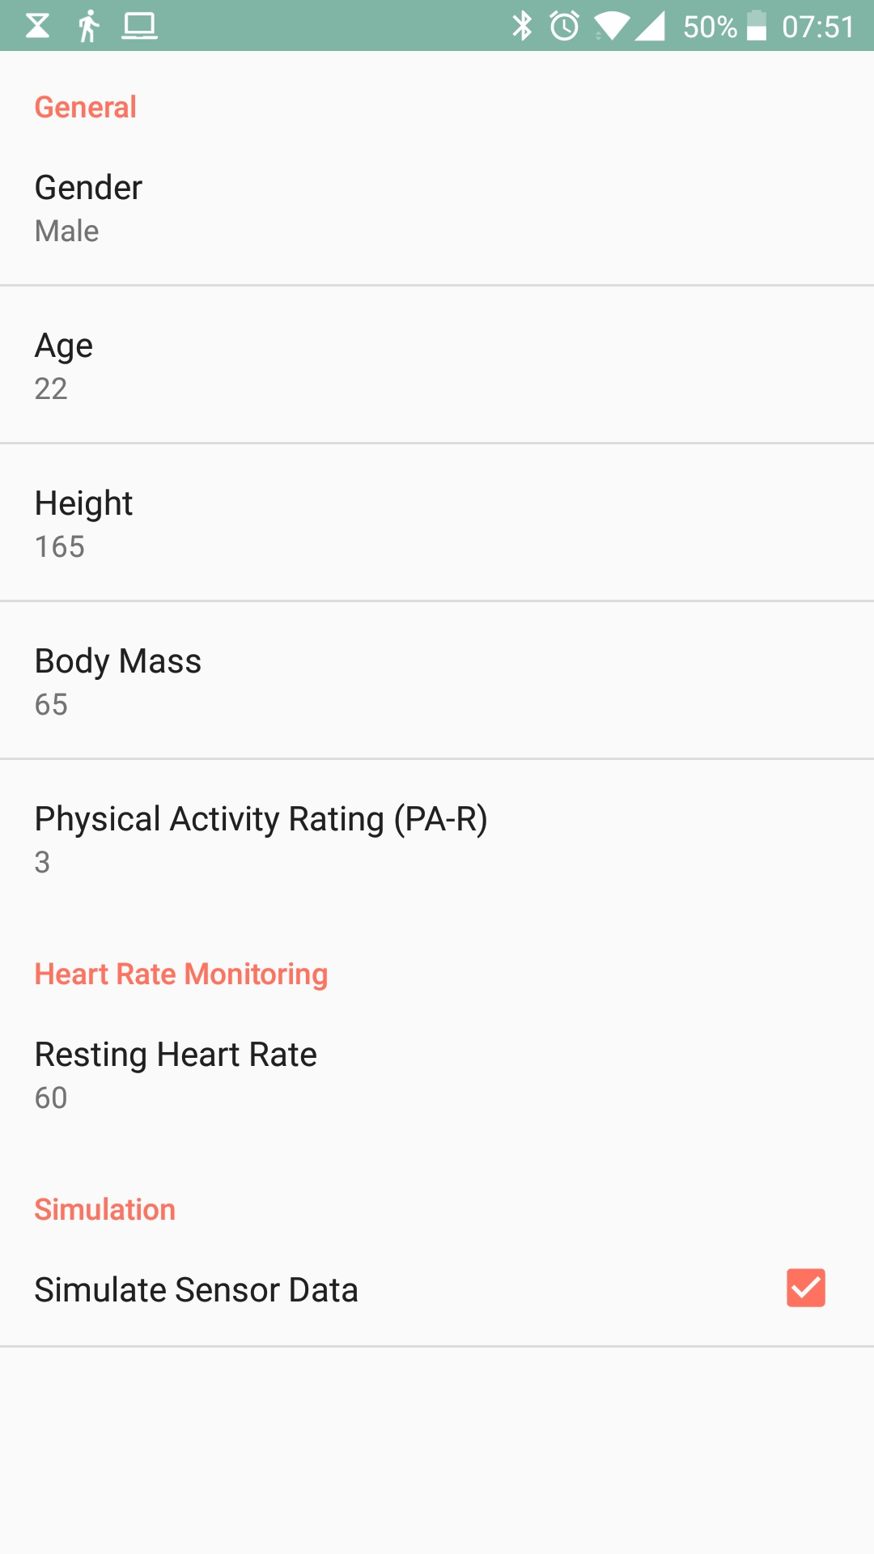
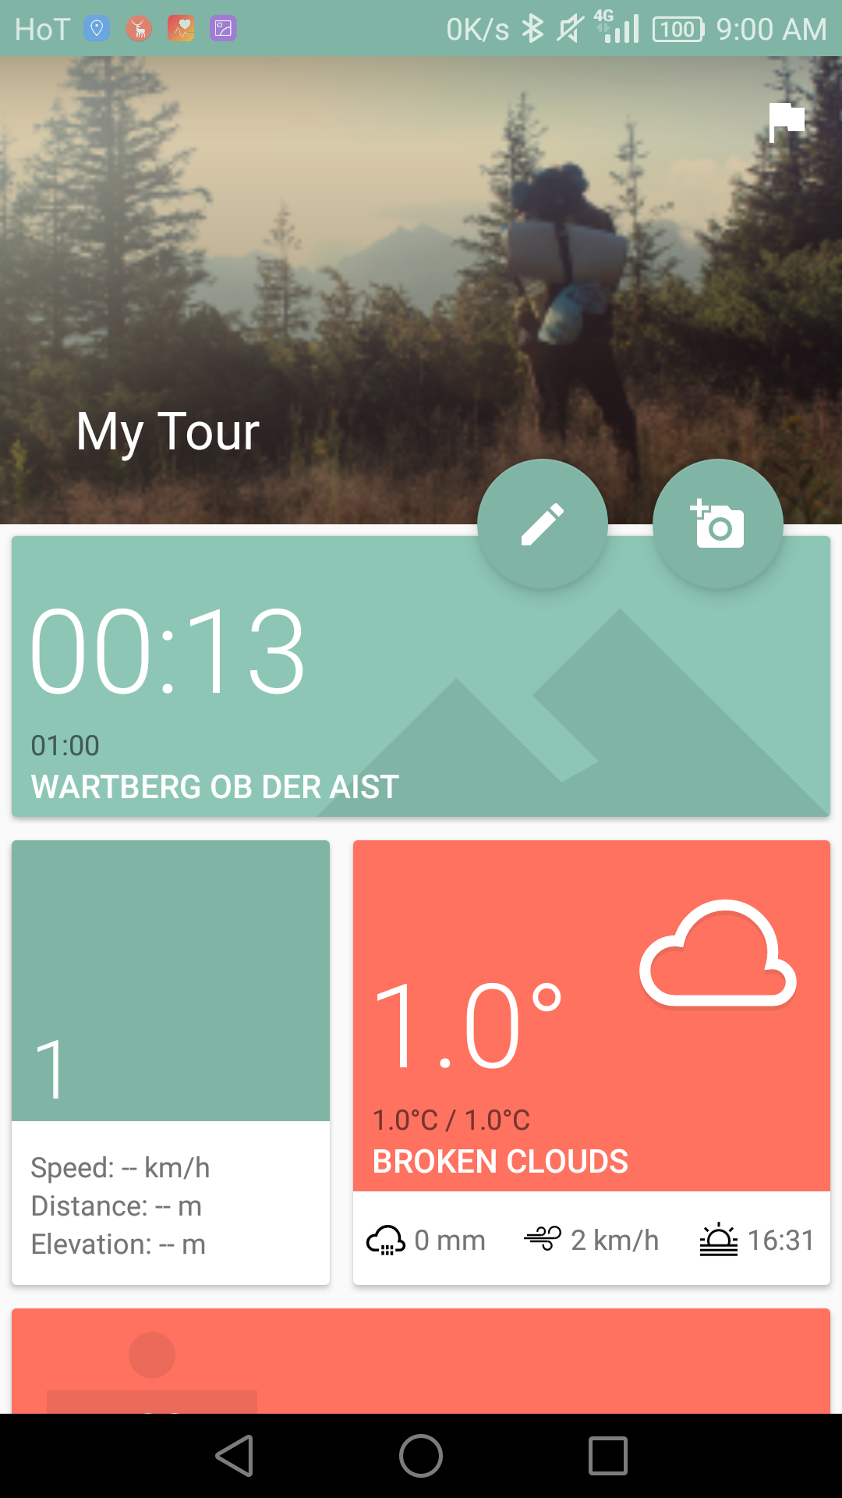
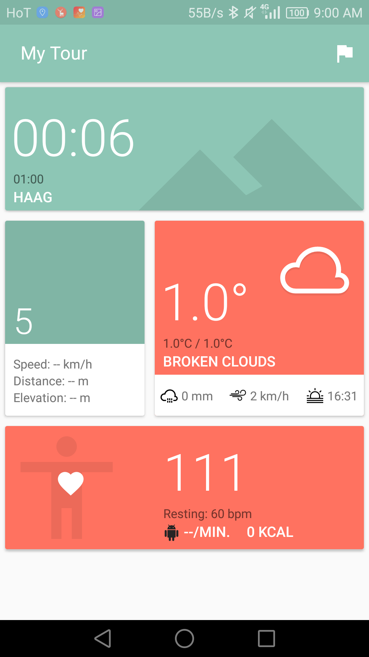
Android App Design #3

Slide 28
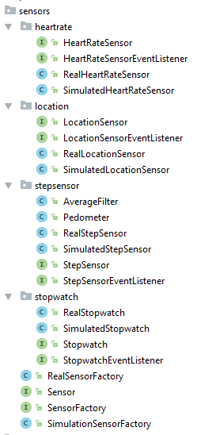
Behind the Scenes #1
Basically refactored everything
Factory Pattern
Interface for Everything!
Simulation for all Sensors

Slide 29
Behind the Scenes #2
Dependencies
Firebase
AndroidAnnotations
Retrofit
EventBus
Kotlin anyone?

Slide 30
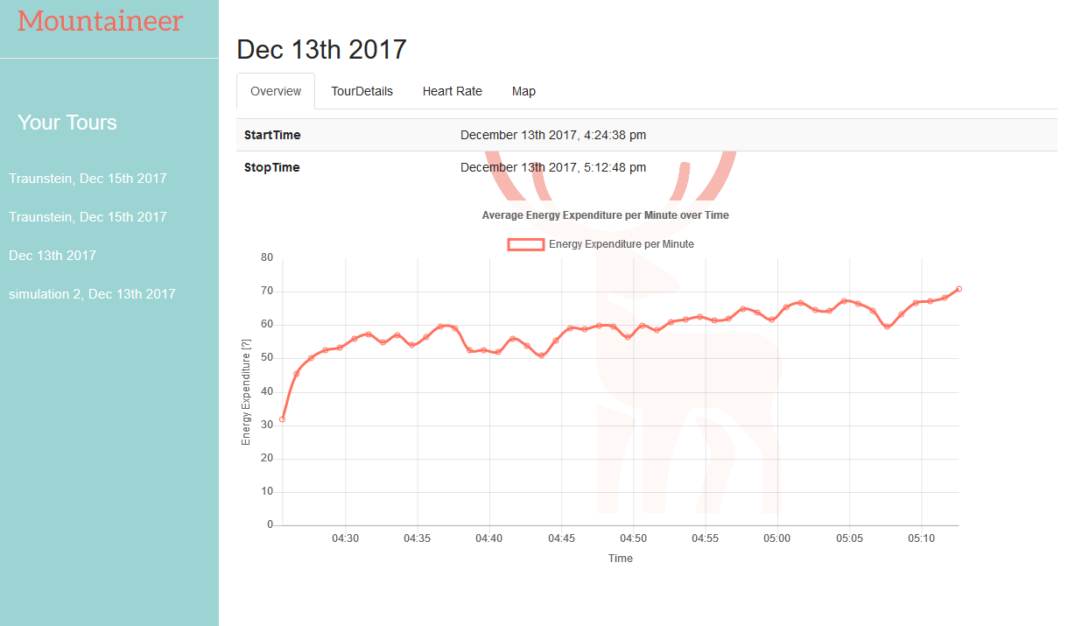
Website #1
Energy Expenditure

Slide 31
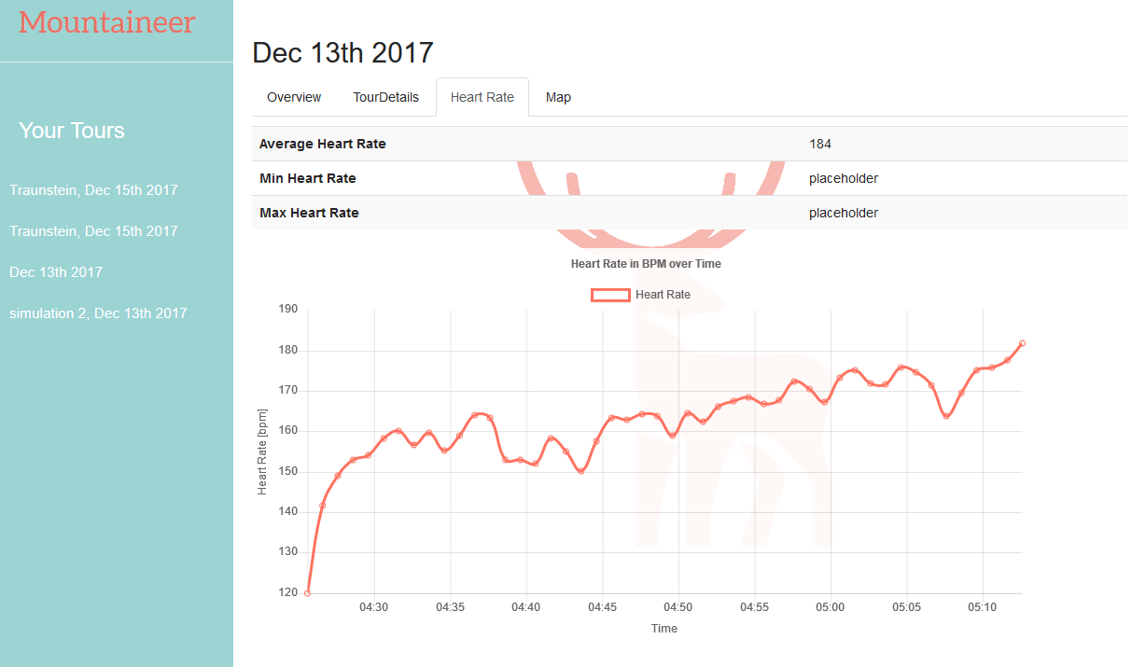
Website #2
Heart Rate

Slide 32
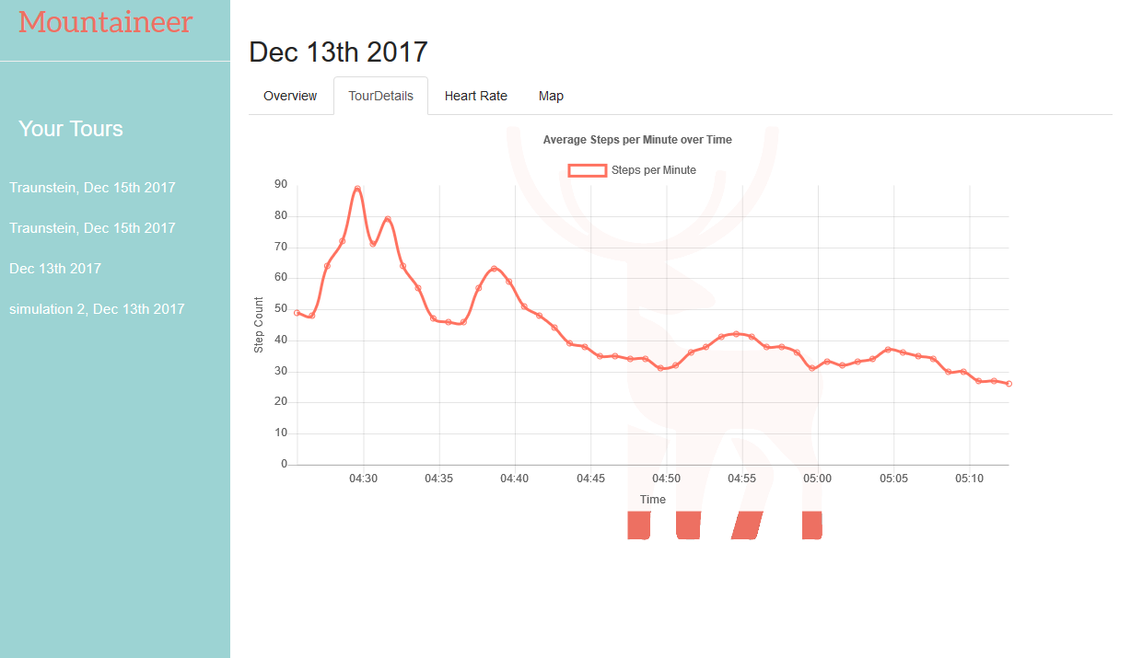
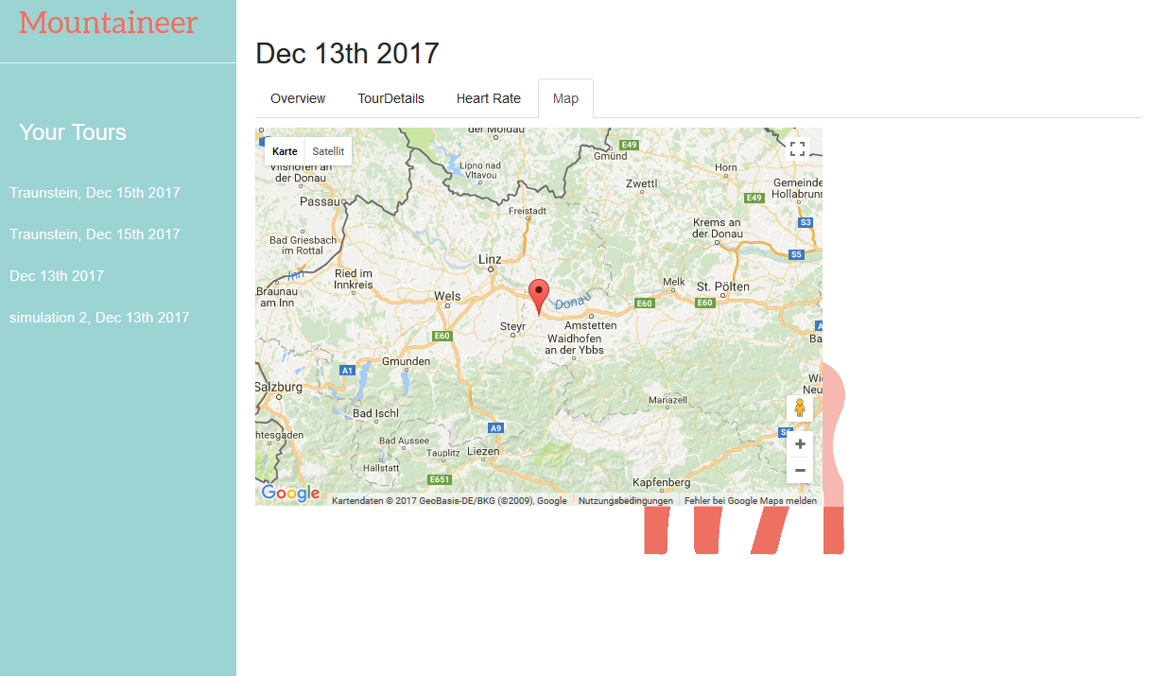
Website #3
Step Count, Map

Slide 33
Website #4
Single Page
Everything in JavaScript
jQuery - why not?
bootstrap - UI components
doT.js - template engine
firebase.js - database api
chart.js - charts
moment.js - date/time library

Slide 34
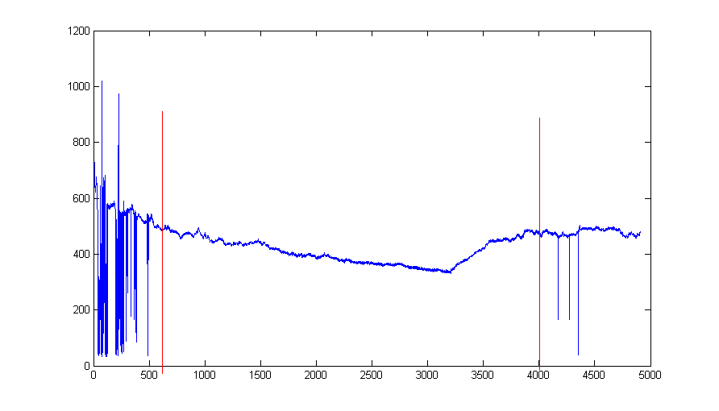
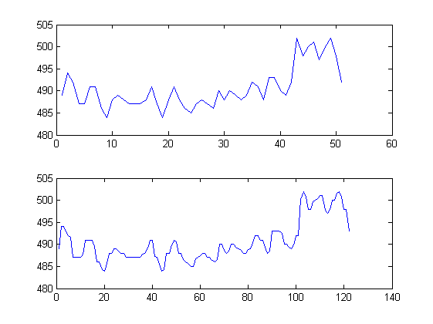
Respiration Frequency #1
Raw Data
Original Data
Resampled Data

Slide 35
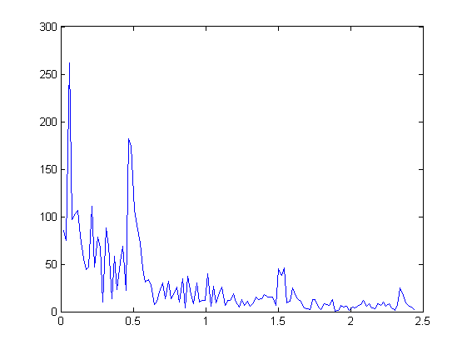
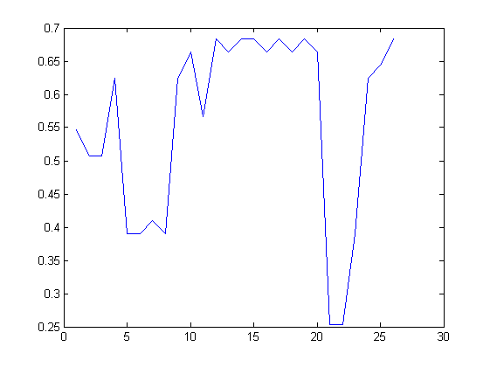
Respiration Frequency #2
FFT of 256 samples
Respiration Freq. Over Time

Slide 36
Respiration Frequency #3
Implemented in Matlab
Not sure if calculations are correct
Time (on x-axis) not correct

Slide 37
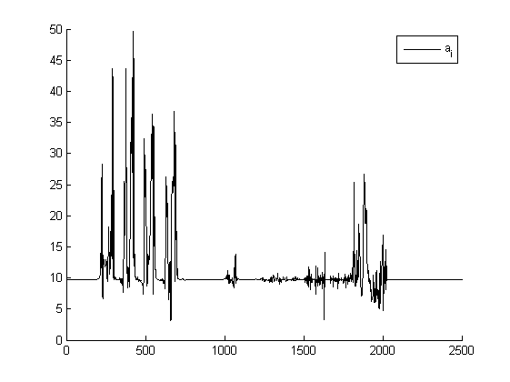
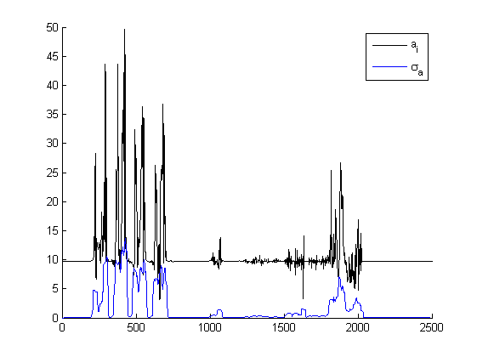
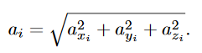
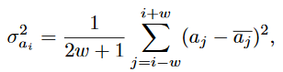
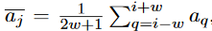
Detect Steps (Jiménez) #1
magnitude of acceleration
local acceleration variance

Slide 38
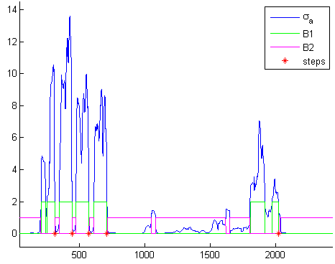
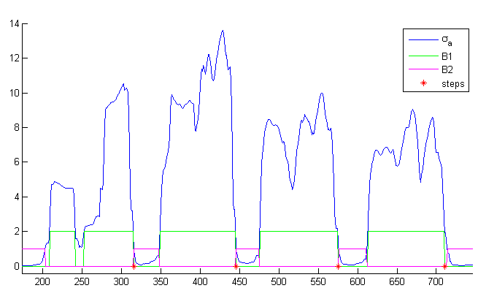
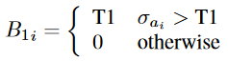

Detect Steps (Jiménez) #2
thresholds and steps
thresholds and steps (detailed)

Slide 39
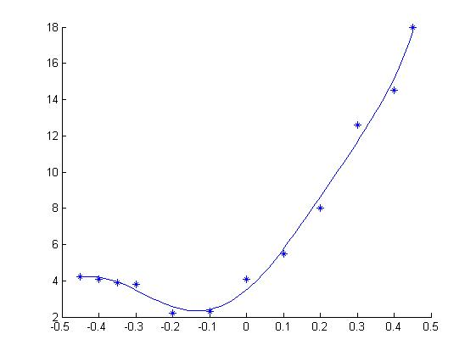
p = 447.6164 267.6918 -206.1911 -65.5996 60.2650 17.3737 3.4912

Slide 41
Mountaineer
The D is silent.

Slide 42
Motivation

Slide 43
Sport in Austria
Source: Statistik Austria - Ergebnisse im Überblick: Körperliche Aktivität (2014)

Slide 44
Conclusion
We‘re lazy as fuck

Slide 45
Problem

Slide 46
Problem
Existing Apps are not designed for moutain climbers
They miss some important information:
Covered altitude
Calculation of calories
Weather information

Slide 47
Mountaineer
Is the solution.

Slide 48
Functionality

Slide 49
For Clarification
MOSProject
Assignments
Mountaineer
Prototype Application
MountaineerWeb
Visualization of Data

Slide 50
Functionality
The Android Application.

Slide 51
Functionality
Add tours/trips
Monitor weather and health information
Display details of completed tours
Tracking of altitude

Slide 52
What kind of Details?
General information
Track/Route details
Weather information
Health

Slide 53
Technical Stuff
Firebase
For Training Units
Used for Fast-Prototyping
Dedicated Database on Webserver for Production
Subject to change without prior notice.

Slide 54
Preview

Slide 55
In Detail

Slide 56
Functionality
The Website.

Slide 57
Website
Energy Expenditure

Slide 58
Website
Heart Rate

Slide 59
Website
Step Count, Map

Slide 60
Functionality
The Assignments.

Slide 61
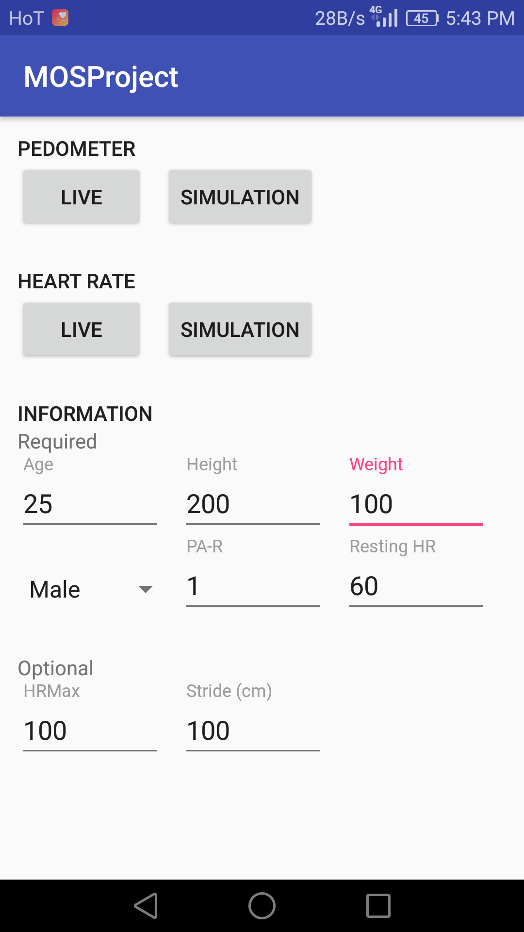
MOSProject

Slide 62
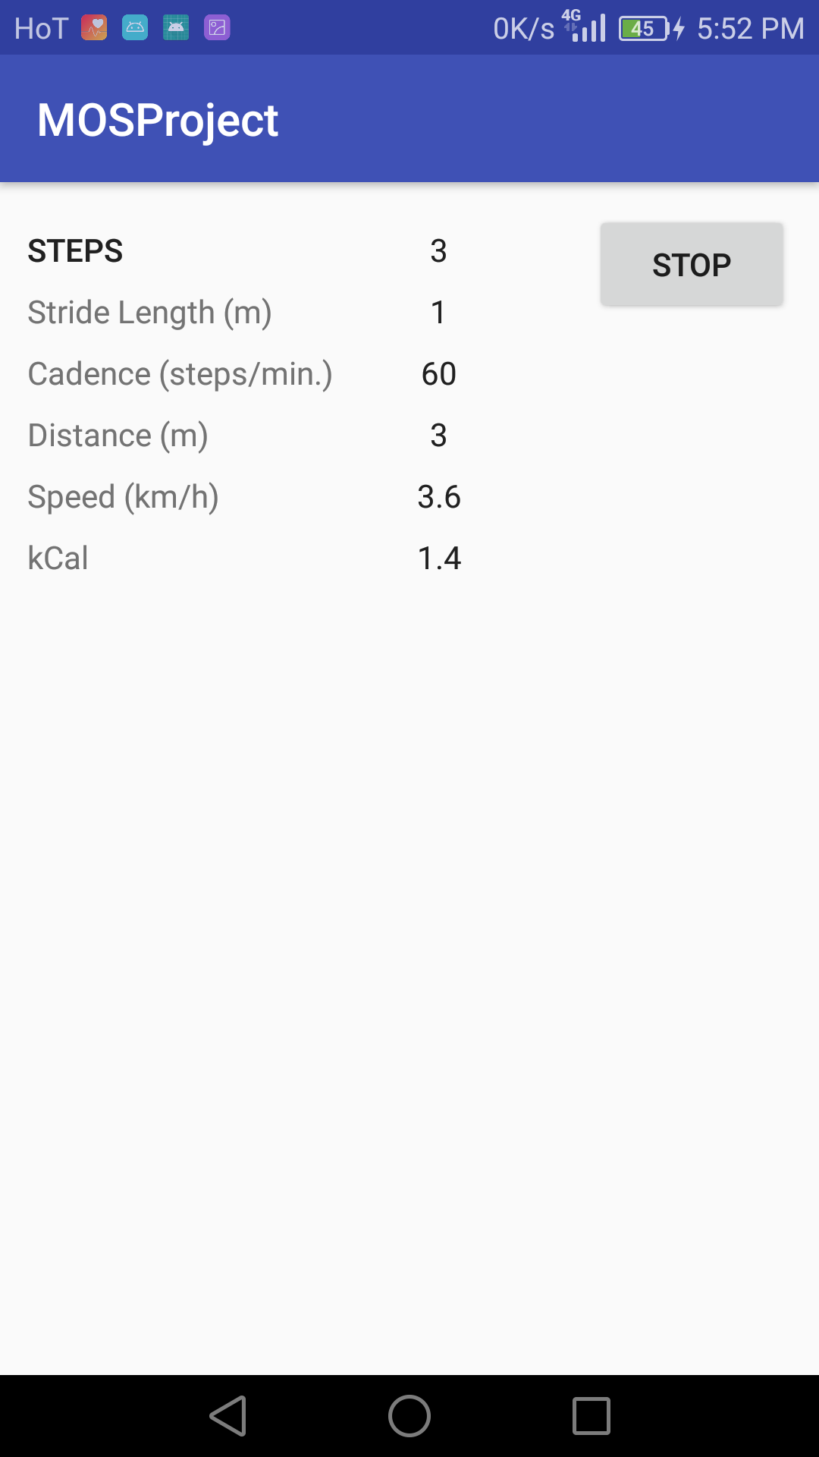
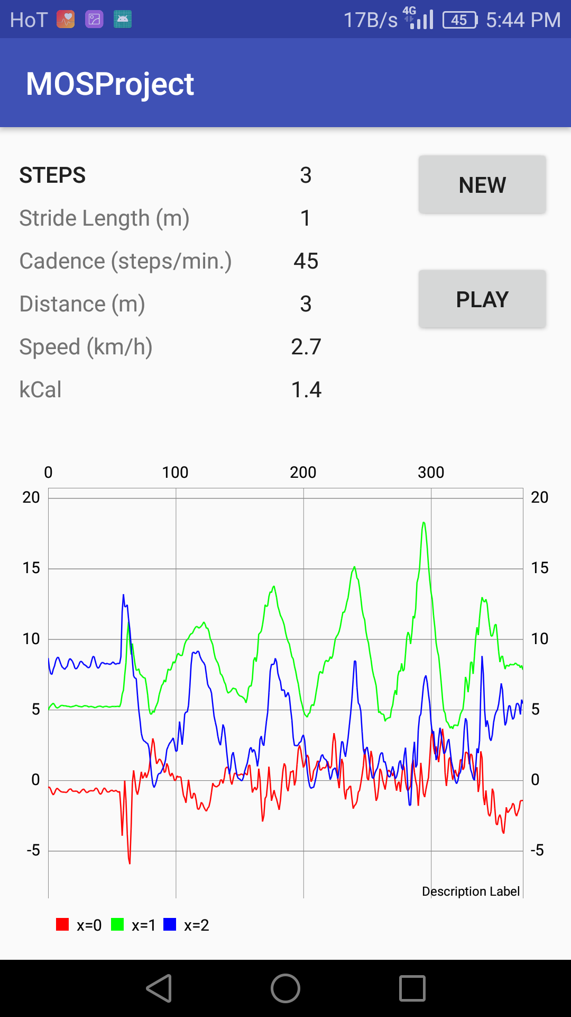
Pedometer

Slide 63
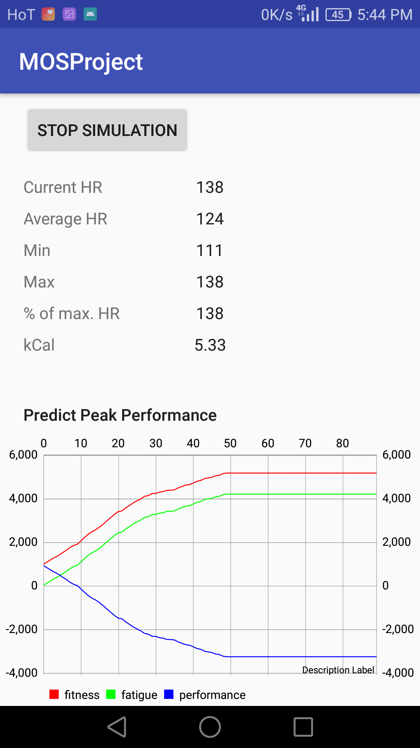
Heart Rate

Slide 64
// TODO
Subject to change without prior notice.

Slide 65
// TODO
MOSProject
Predicting Finishing Times
Altitude
SRTM
Garmin Connect IQ
Mountaineer
Adaptations, etc.
Proper Documentation
Subject to change without prior notice.

Slide 66
Thanks!

